Slide 1
CMPE-202
TEAM NINTENDO
BY ROHIT SHARMA , TARUN ARORA, RACHIT CHOKSI, SRIVATSA MULPURI

Slide 2
CLASS DIAGRAMS

Slide 3
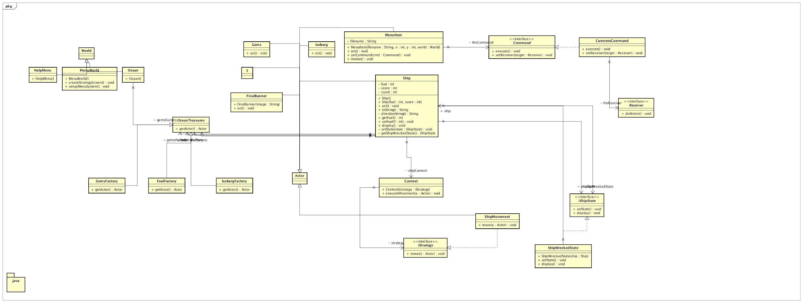
GAME CLASS DIAGRAM

Slide 4
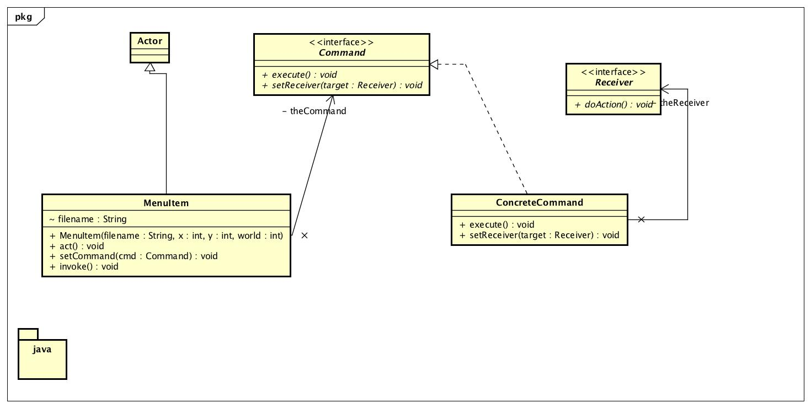
Class Diagram
CLASS DIAGRAM:COMMAND PATTERN

Slide 5
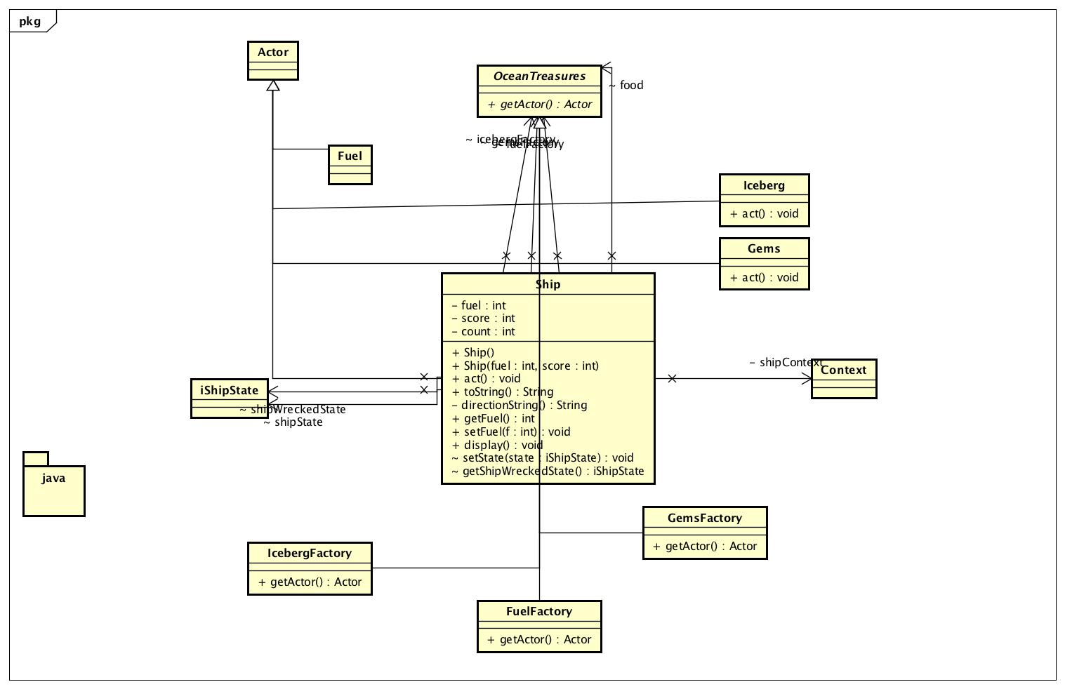
CLASS DIAGRAM :STATE PATTERN AND FACTORY PATTERN

Slide 6
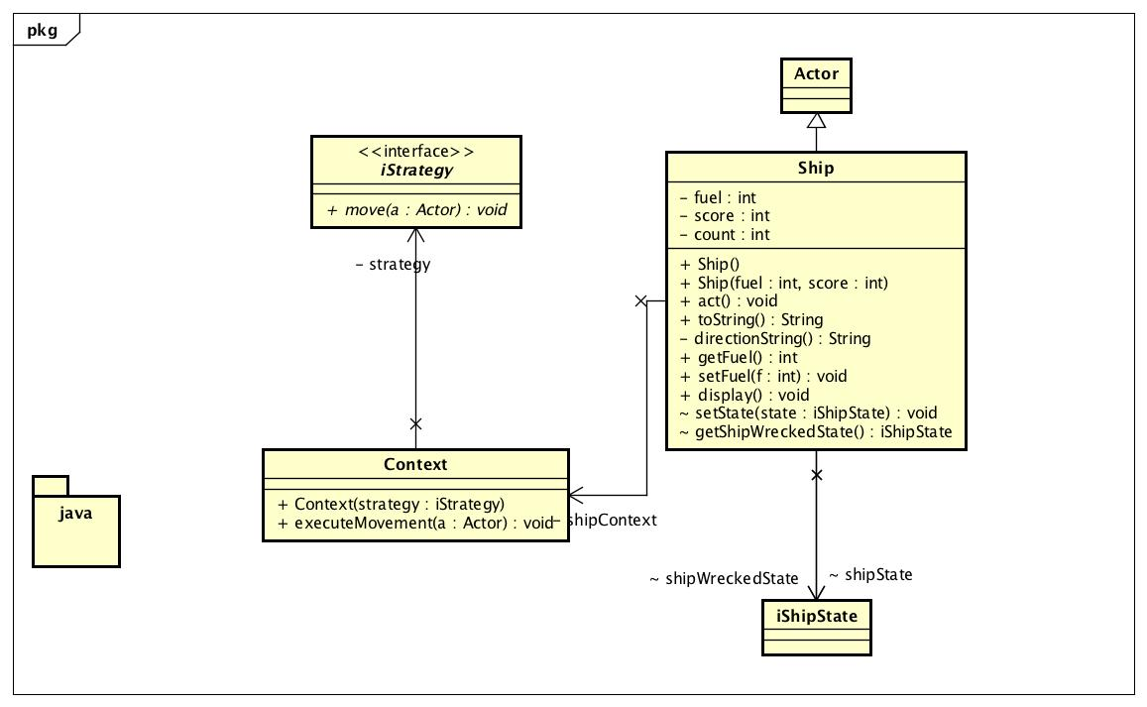
CLASS DIAGRAM :STRATEGY PATTERN

Slide 7
ACTIVITY DIAGRAM

Slide 8
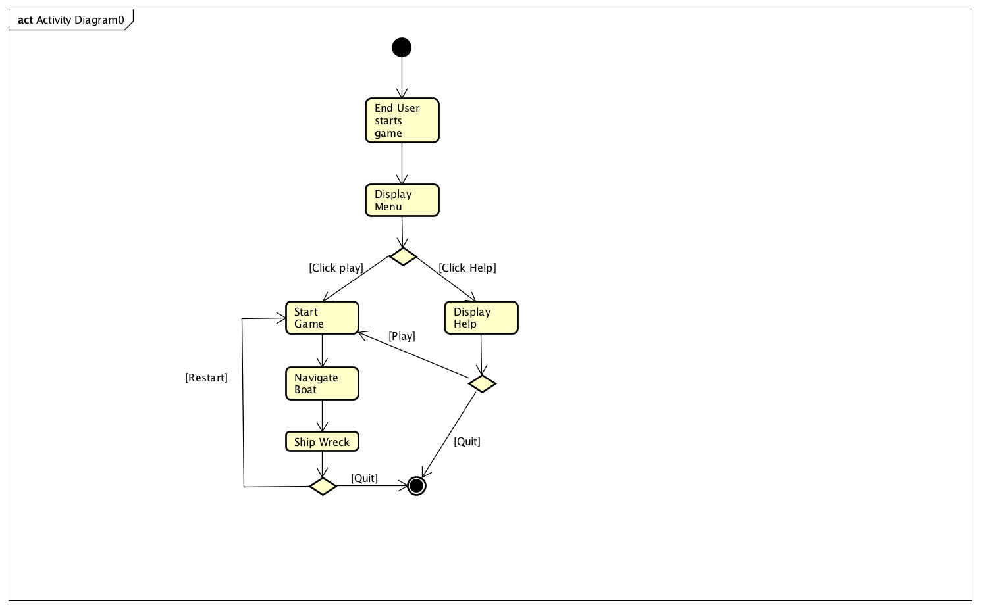

Slide 9
SEQUENCE DIAGRAMS

Slide 10
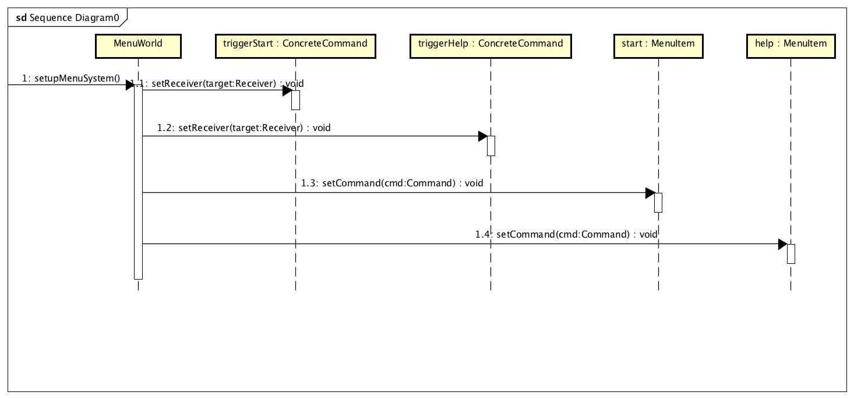

Slide 11
USE CASE DIAGRAM

Slide 12
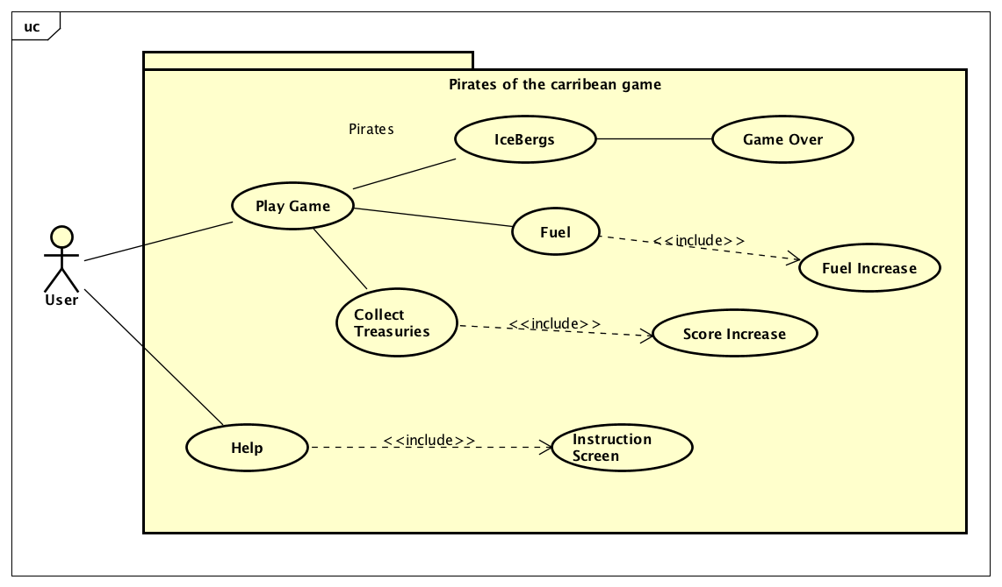

Slide 13
USE CASE SPECIFICATION
DIAGRAM

Slide 14
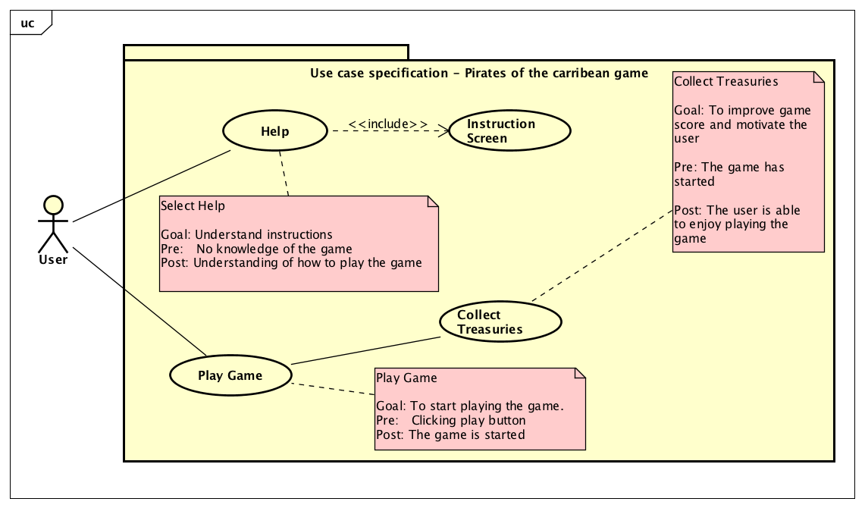

Slide 15
BURNDOWN CHART

Slide 16
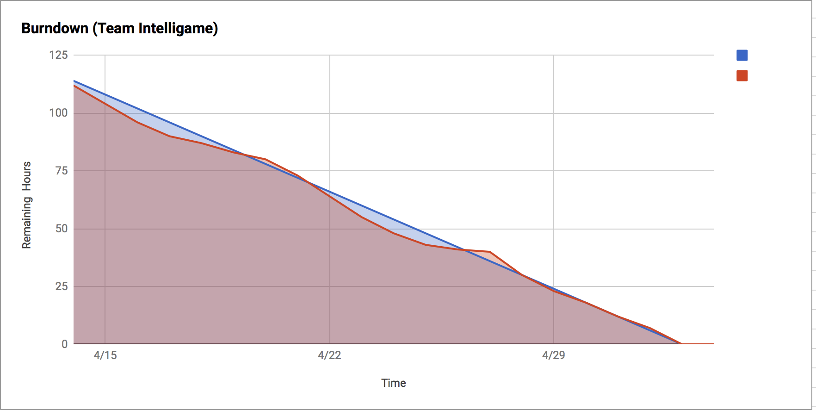

Slide 17
FINAL SCRUM TASK
BOARD

Slide 18
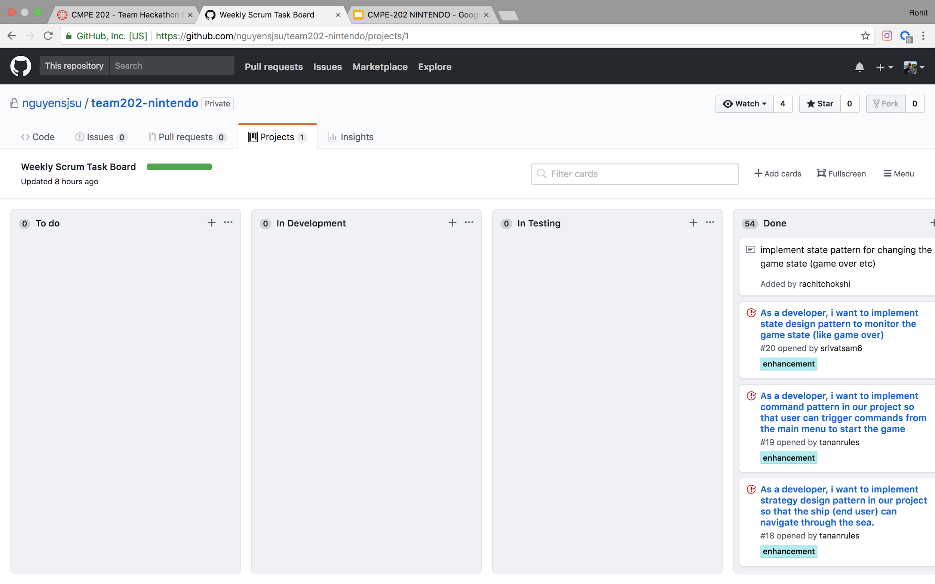

Slide 19
Links to our Github Repo
https://github.com/nguyensjsu/team202-nintendo
Link to our Team’s Project Board(on Github)
https://github.com/nguyensjsu/team202-nintendo/projects/1
Link to our Team’s Project Journal(on Github)
https://github.com/nguyensjsu/team202-nintendo/tree/master/documentation/XPValuesJournal
Link to our Team’s Sprint Task Sheet
https://docs.google.com/spreadsheets/d/1uMhdGAArmFjbeyOLymzqEFupie901vIo08q7DsNsNBI/edit?usp=sharing
Link to our Team’s Ad Video on Youtube:https://youtu.be/SLBnjXfY4VQ

